Slide 1
Azure DevOps – Templating your Pipelines and Keeping them DRY!
Thomas Thornton
Kainos

Slide 2




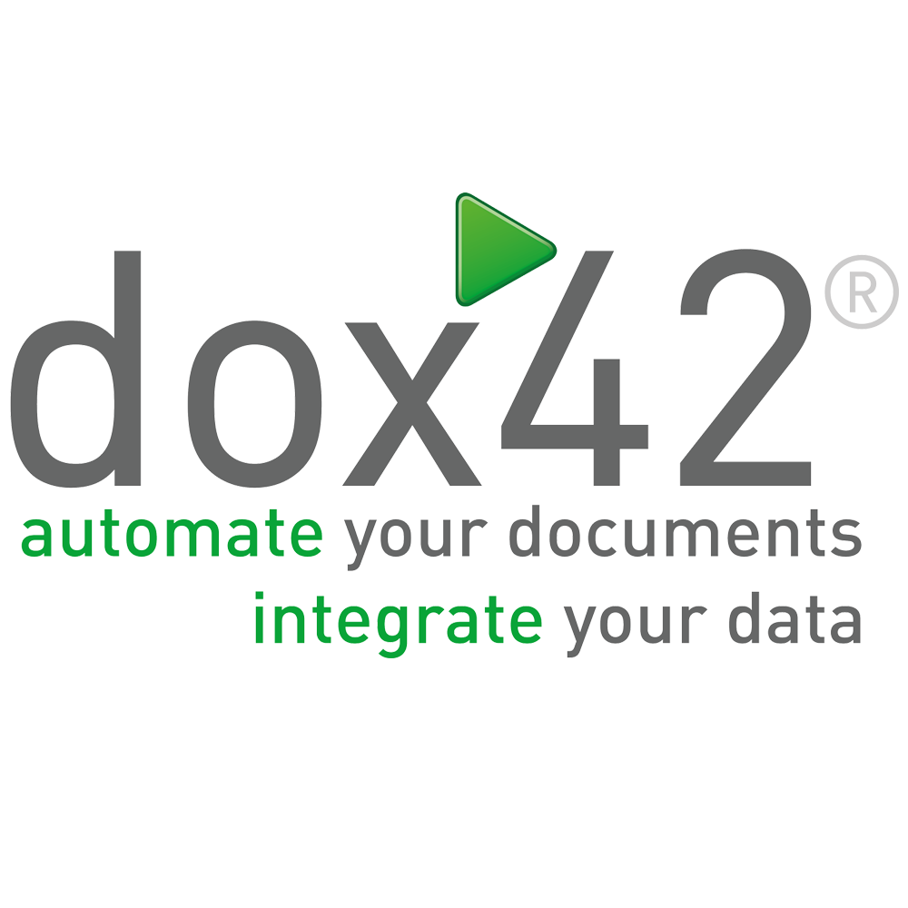

Thank You to our Sponsors…
Event Sponsor
Platinum Sponsors

Slide 3



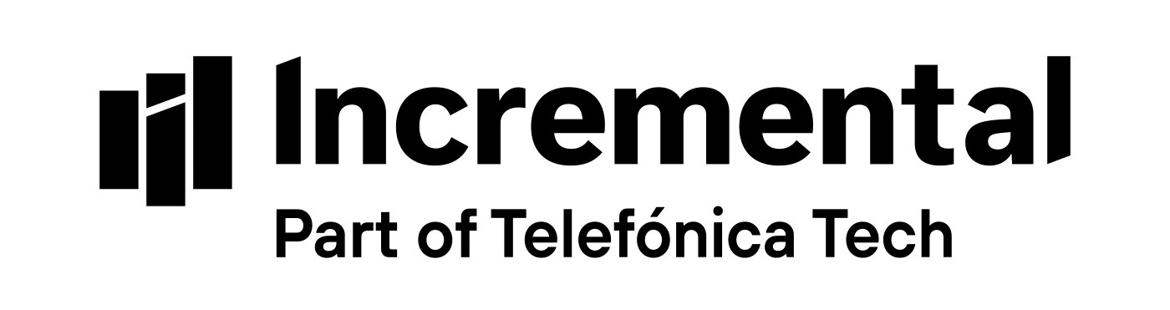




Thank You to our Sponsors…
Gold Sponsors
Data Quality
Event Lunch
Accessibility
Data Analytics

Slide 4



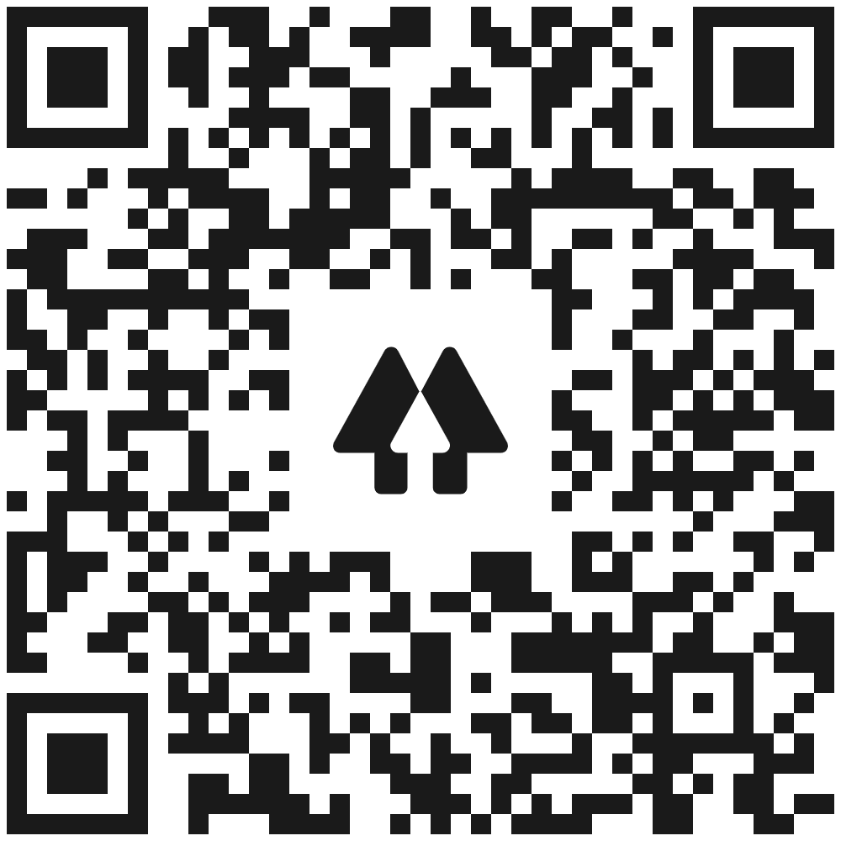



Speaker Thomas Thornton
www.linkedin.com/in/thomasthornton1
Azure Technical Specialist
Kainos
Microsoft MVP
Azure & DevOps Advocate
Azure Certified
Azure Blogger
“It’s OK to be not OK”
https://www.linkedin.com/in/thomasthornton1
https://thomasthornton.cloud/
https://twitter.com/tamstar1234
https://github.com/thomast1906
https://linktr.ee/tamstar1234

Slide 5


Initial Questions
Copy & pasting the same stage between different pipelines?
Creating the same task several times?
Copy and pasting the same job or stage?
Noticing repetition over time?
“It’s OK to be not OK”

Slide 6

What will we cover?
Why DRY?
Azure DevOps - Templating
Questions
DRY – what does it mean?
Keeping Azure DevOps Pipelines DRY
Example scenario

Slide 7
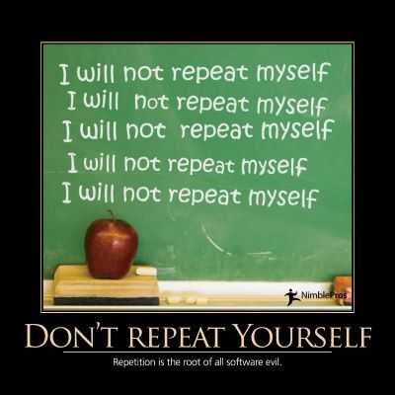
Don’t Repeat Yourself (DRY)
"Don't repeat yourself" (DRY) is a principle of software development aimed at reducing repetition of software patterns, replacing it with abstractions or using data normalization to avoid redundancy © Steven Foote

Slide 8
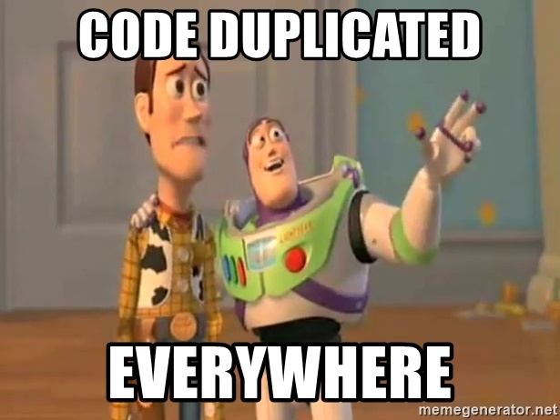
To me, what does DRY mean?
Avoid duplication if possible
Don’t copy & paste
Structure, structure and more structure
Create logic within your pipelines
Think reusability

Slide 9




Questions to consider when creating an Azure DevOps Pipeline
Repetition
Less Code
Duplication
Reusability
How many times has the configuration been repeated?
Can I write the pipeline with less code, removing repetition?
Is duplication needed? Can it be removed?
Will refactoring make this pipeline easier to maintain in the future?

Slide 10
How can I keep my Azure DevOps Pipeline DRY?
Parameters & Variables
Avoid duplication
Expressions
Templating!
Utilise the use of parameters and variables
Don’t copy & paste
Create expressions and conditions within your pipeline
More on that soon ☺
Recommended Blog Post: https://thomasthornton.cloud/2021/01/20/azure-devops-pipelines-keeping-your-pipelines-dry/

Slide 11



Azure DevOps Pipeline Templates What are they?
Templates let you split your pipeline into several files (Templates)
Templates let you split your pipeline into several files (Templates)
You may be aware of the Separation of Concerns principle

Slide 12
Azure DevOps – Creating Pipelines
Multi-Stage
DRY
YAML
Template Pipelines
There is always that situation where we need to use the same stage, task etc in several places
We want to avoid copy and pasting, adhering to DRY
Can bloat over time, what can we do?
This is where pipeline templates become super useful!

Slide 13
Azure DevOps Pipeline Templates
Pipeline Templates allow us to define reusable code blocks within your YAML
Making maintenance a lot easier and less prone to errors!
We can define steps, jobs, stages etc

Slide 14
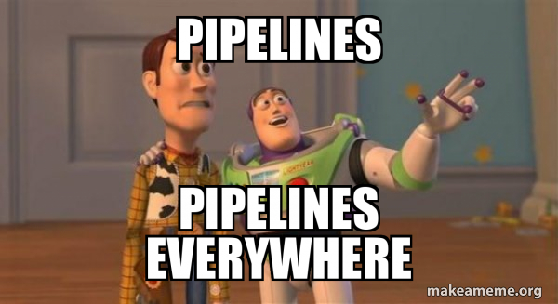
Azure DevOps Pipeline Template Structure
Looking at the structure, we can define the below in our templates
Parameters
Variables
Steps
Jobs
Stages
Conditions

Slide 15
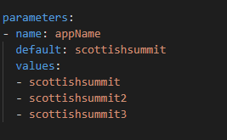
Pipeline Structure - Parameters
Parameters help to pass values from main pipeline into our templates
Parameters must be defined with a name and a type, a default value is optional

Slide 16
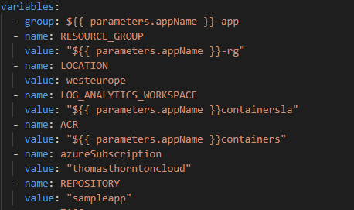
Pipeline Structure – Variables
Variables in a pipeline template are used similarly as we would as a Variable Group
Variables can be used throughout your pipeline and templating
Parameters can be referenced in variables to concatenate values

Slide 17
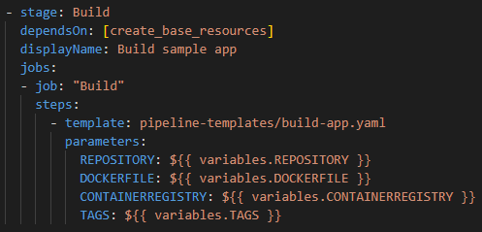
Pipeline Structure – Stages, Jobs & Templates
This is where the fun begins!
Creating a stage, we can begin to reference templates pre-made!
Notice the Job reference “build”? It is deploying a templated step

Slide 18
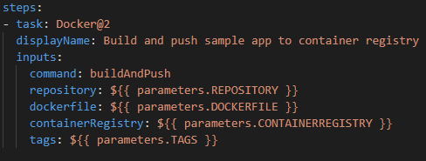
Pipeline Structure – Steps
When creating a template to reuse, we usually want to create one or more steps in a job of a pipeline.
Simply define the steps in the template, as we would in a YAML pipeline

Slide 19
Pipeline Structure – Steps Template
Following on, look at the steps task within a template
Notice the reference of parameters?
Steps task Docker@2 uses these parameters
No copy/pasting ☺

Slide 20
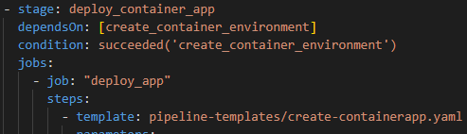
Pipeline Structure – Conditions
Conditions are written as expressions in YAML pipelines
You can specify the conditions under each stage, job, or step runs

Slide 21

Example Scenario
I will now show an example scenario of a pipeline with no templates to a pipeline using what I have showed in the previous few slides!

Slide 22
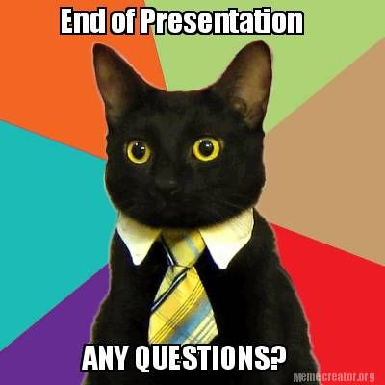
I will leave you with some final thoughts
Less code means less code to maintain
Try to avoid duplication
DRY!
Make your pipelines reusable
Make it easy to re use
Enjoy the journey ☺

Slide 23

Thank You to our Sponsors!
Event Sponsor
Platinum Sponsors

